Slide 1
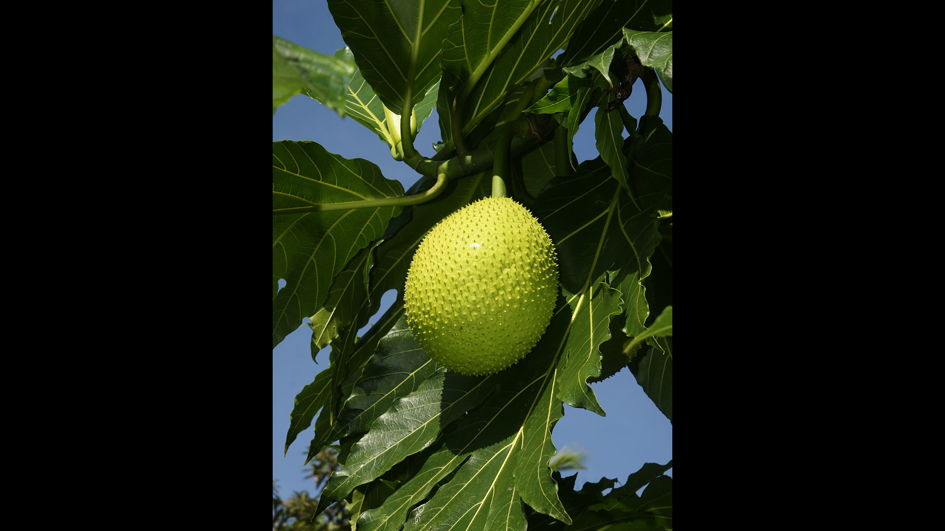
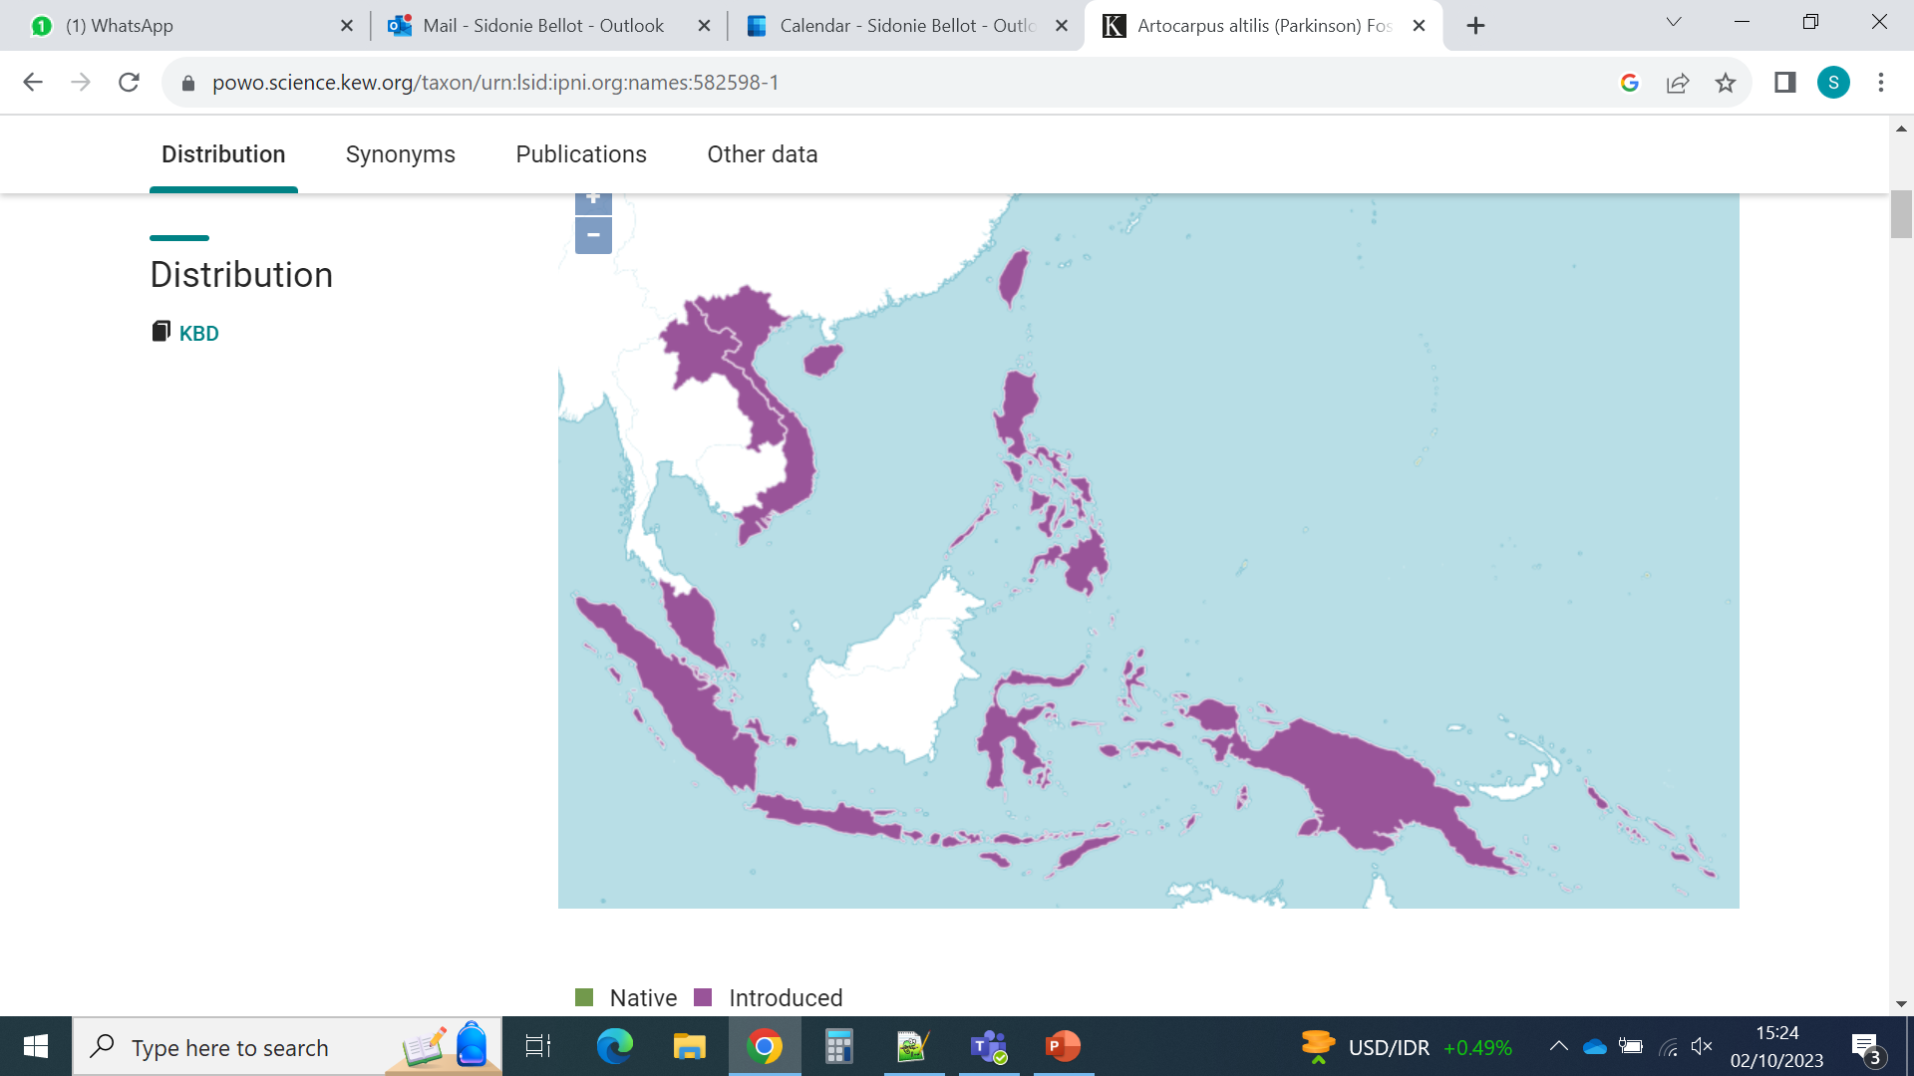
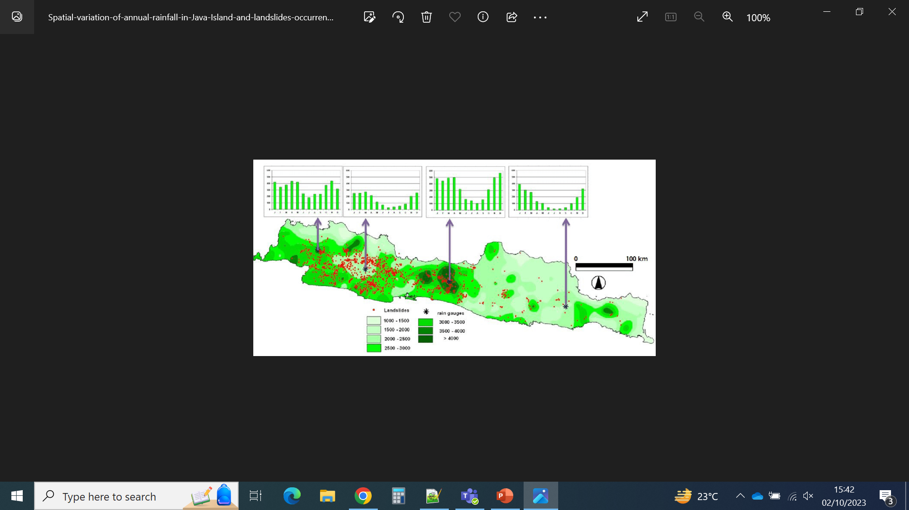
Case study: did breadfruit develop genetic adaptations to local climates?
Artocarpus altilis
distribution
(introduced)
https://powo.science.kew.org/
Rainfall variation in Java
Hadmoko et al., 2017, Forum Geografi 31

Slide 2
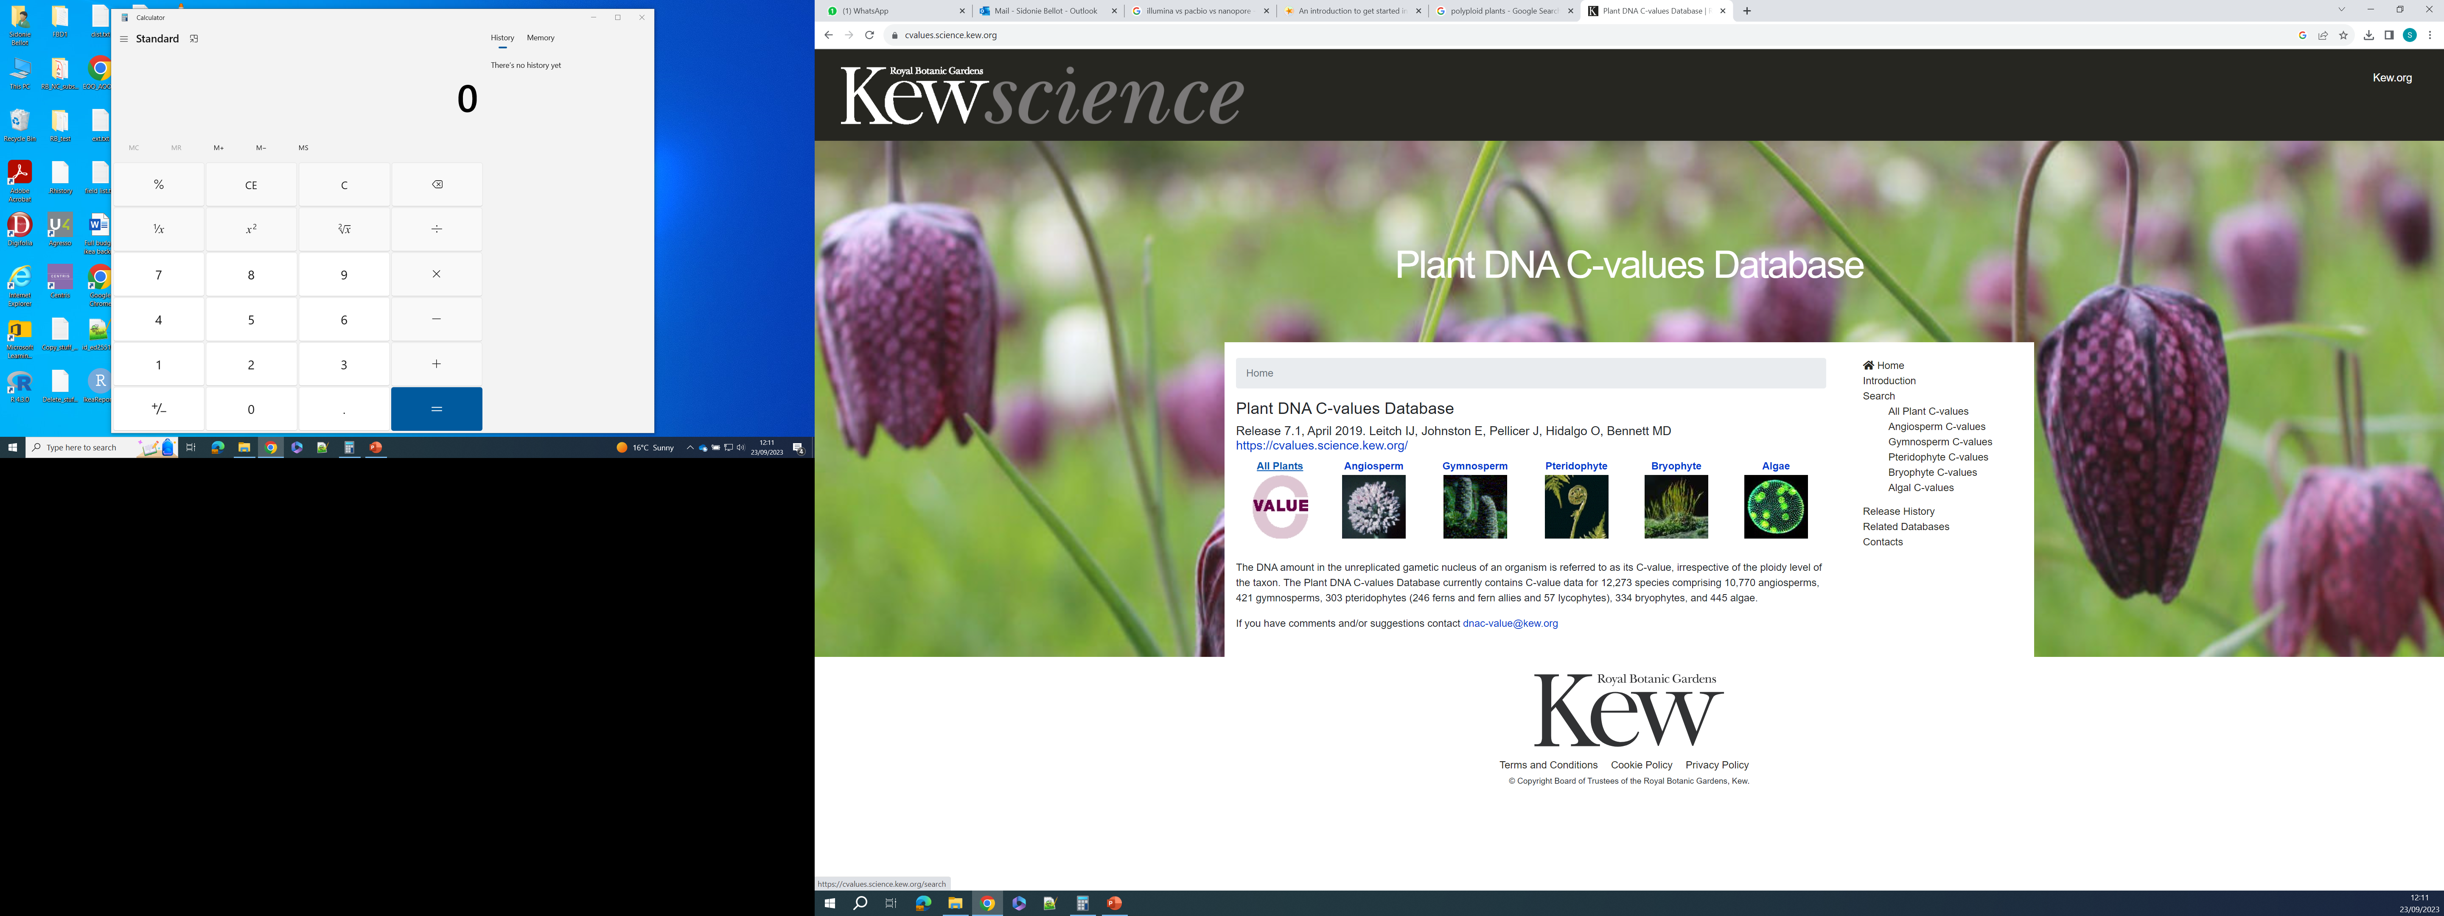
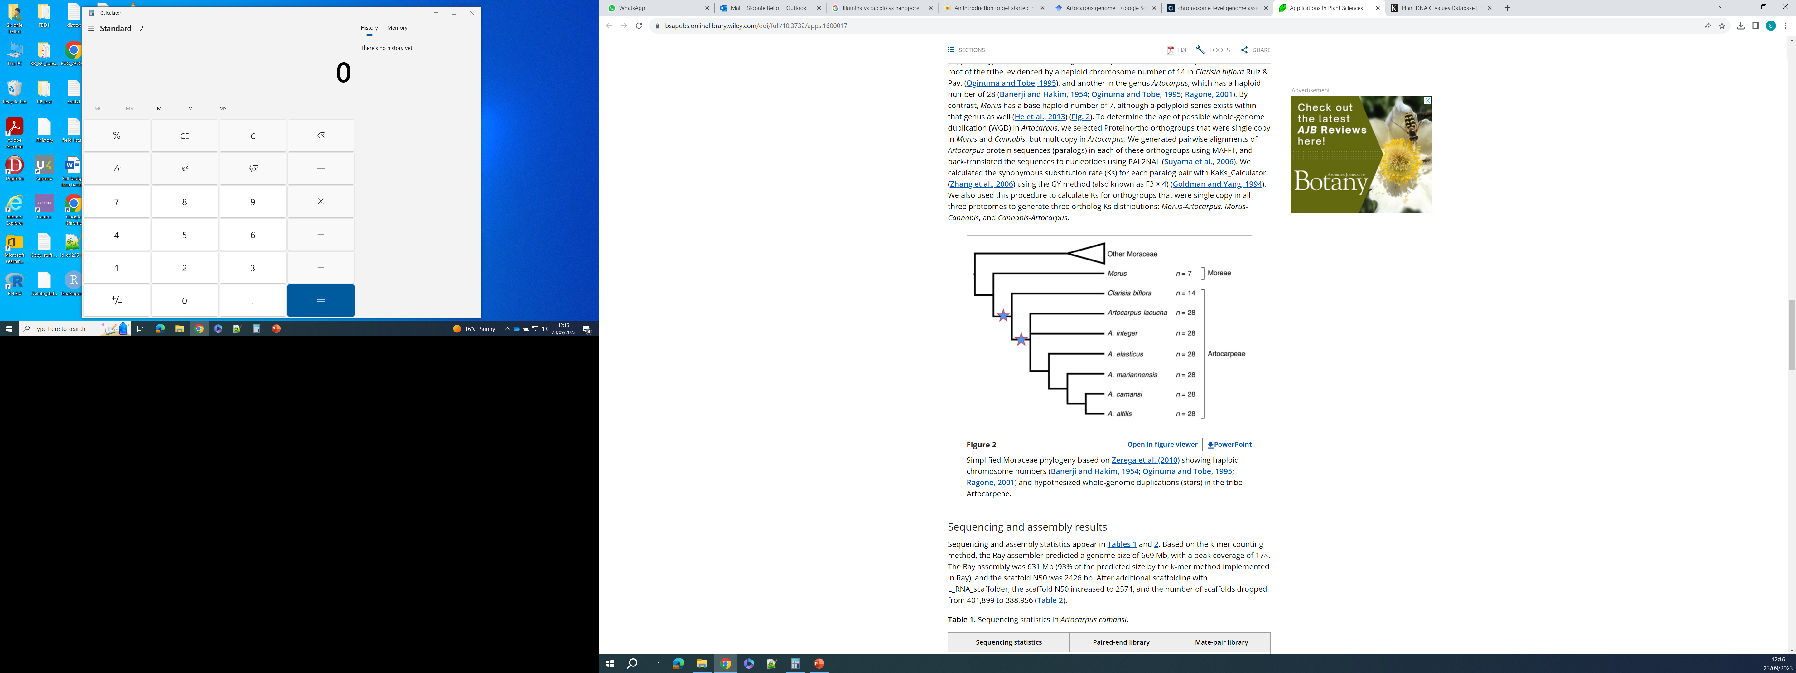
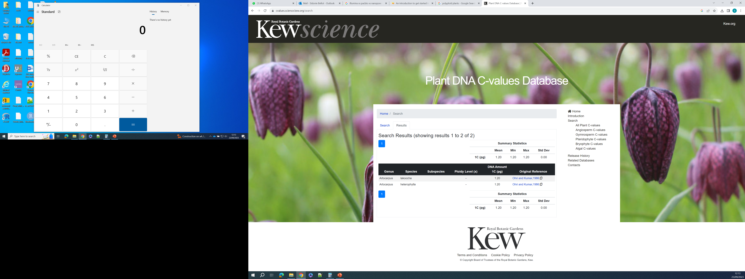
Case study: did breadfruit develop genetic adaptations to local climates?
From Gardner et al., 2016, Appl Plant Sci. 4(7): apps.1600017
Artocarpus genomes seem not too big, they are diploid (but paleopolyploids)
Reference genomes exist (mostly drafts)

Slide 3
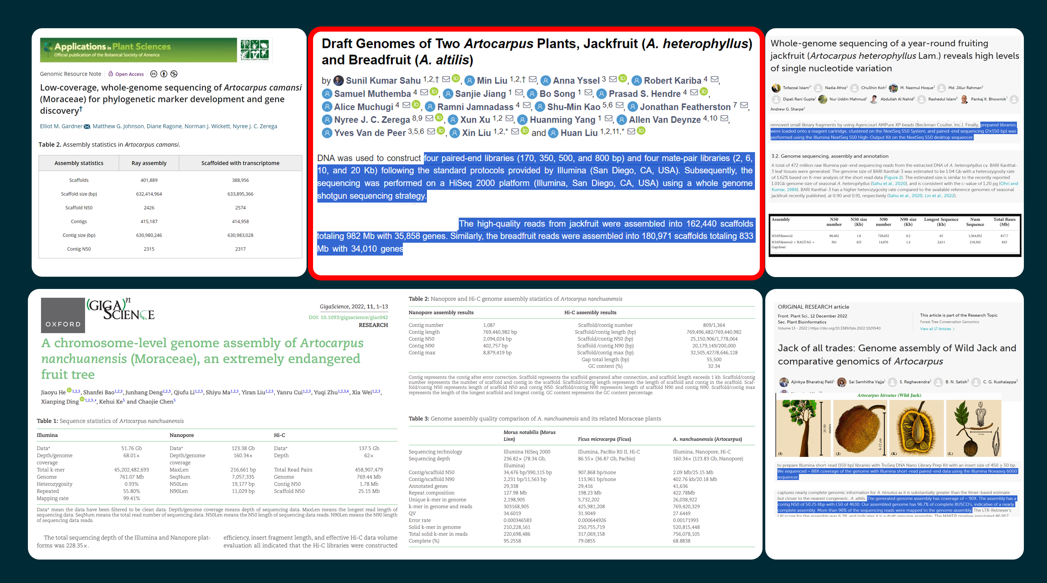

Slide 4
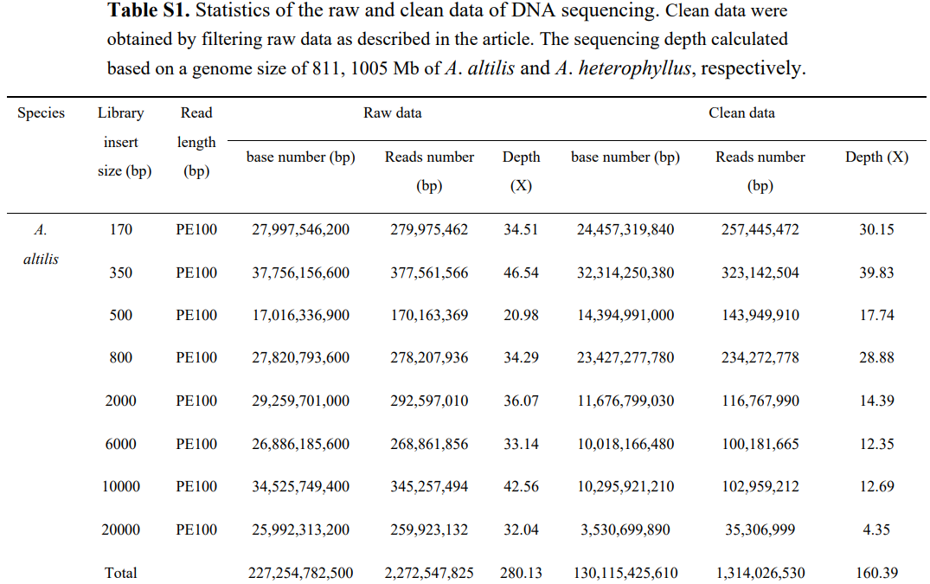

Slide 5

Exercise: sequencing success of the breadfruit genome
Assuming that A. altilis has a genome size of 1.2 Gbp
What was the average coverage expected by Sahu et al before they use their data?
What % of coverage did they achieve?
What was the average coverage achieved across the whole genome?
What was the average coverage achieved across the assembled genome?
Do you think the genome has been entirely sequenced and assembled?
What do we need to do better?

Slide 6

Solutions: sequencing success of the breadfruit genome
Assuming that A. altilis has a genome size of 1.2 Gbp
What was the average coverage expected by Sahu et al before they use their data?
Expected coverage: #bp sequenced / genome size = 227,254,782,500/1,200,000,000
= 189x
What % of coverage did they achieve?
%coverage = Total scaffolds length / genome size = 833*100/1200 Mb = 69.4%
What was the average coverage achieved across the whole genome?
Average achieved coverage: # good quality bp / genome size =
130,115,425,610 /1,200,000,000 = 108x
What was the average coverage achieved across the assembled genome?
Average achieved coverage: # good quality bp / Total scaffold length =
130,115,425,610 /833,000,000 = 156x
Do you think the genome has been entirely sequenced and assembled?
What do we need to do better?

Slide 7
Case study: did breadfruit develop genetic adaptations to local climates?
Project
Compare the genomes of breadfruit from drier and wetter places
to see if we find genetic differences correlated with climate
Samples available
Wetter climate: West Java (12 samples)
Drier climate: East Java (12 samples)
Strategy
Produce a draft genome with short + long reads (1 sample from wet place + 1 sample from drier place)
Produce short read data for the 22 other samples
Compare the data from the 22 samples, with the help of the reference genomes
Outcomes
There is not enough statistical power to detect local adaptation, but it is enough for a pilot to get more $$$
The genomes and preliminary results can be published
The data can be used for other applications (DNA barcoding, phylogenetics, demography studies…)

Slide 8
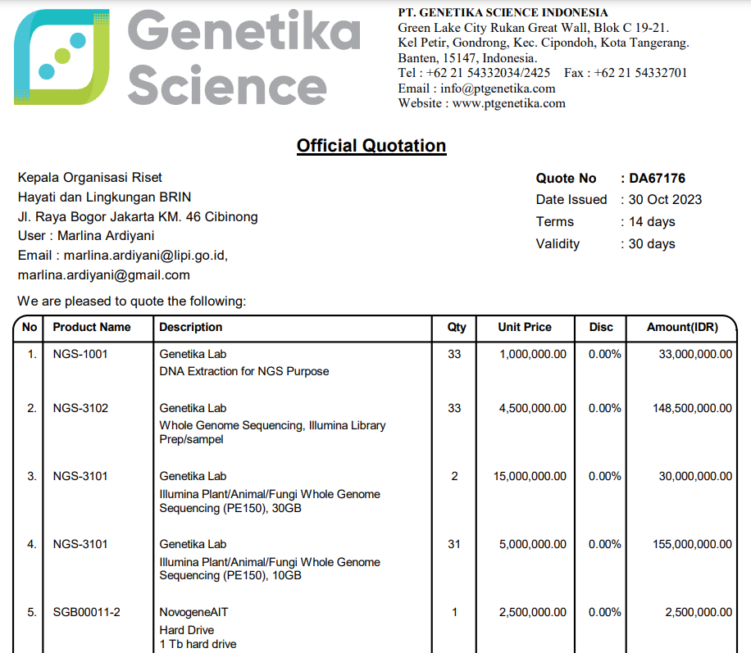
Assuming that A. altilis has a genome size of 1.2 Gbp,
What coverage can we expect for our
31 individuals ?
What coverage can we expect for the
Other 2 individuals?
(NB: the GB number provided is for each individual)

Slide 9
Assuming that A. altilis has a genome size of 1.2 Gbp,
What coverage can we expect for our
31 individuals ?
10,000,000,000/1,200,000,000 = 8.3x
What coverage can we expect for the
Other 2 individuals?
30,000,000,000/1,200,000,000 = 25x
(NB: the GB number provided is for each individual)

Slide 10
Assuming that A. altilis has a genome size of 1.2 Gbp,
How much ONT data did we get ?
What coverage can we expect for each individual sequenced?

Slide 11
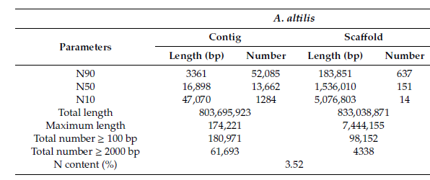
Genome assembly success is also about continuity
Contigs are sequences obtained by overlapping reads
Scaffolds are reconstructed based on information on read proximity (e.g. paired-end or mate-pair sequencing)
Contig 1
Contig 2
TAAGGGACCTATTAAGCCATTATC
NNNNNNNNNNNNNNN
ATGCGTGCAAATCGTGACCAACC
read 1
read 2
Scaffold 1
Nx value: x% of the sequences are longer than the value
E.g.: N50 = 16,898 means that 50% of the contigs are longer than 16,898 bp… and that 50% are shorter than this
N content: 3.52% of the bases in the assembly are N, i.e. unknown (this only considers the assembled part, not the parts of the genome that are not covered at all)

